Slide 1

AMAZON PRODUCT REVIEW ANALYSIS
PRESENETED BY -
ABHAY THAKUR
VINAY KHURANA
SHASHANK WAGLE

Slide 2


THE OBJECTIVE OF THE PROJECT
To classify customers into groups based on their feedback
Develop a customer retention strategy by analyzing customer feedback and identifying different customer segments through clustering analysis.
Use time series analysis to identify trends and seasonality in customer purchase behavior, and predict future purchase frequency.
Data Sets | Review | Review time period
All Beauty Datasets | 3,71345 | 2001-2018
Magazine Subscription Datasets | 89689 | 2001-2018

Slide 3

TABLE OF CONTENT
PREPROCESSING AND CLEANING
SENTIMENT ANALYSIS
EXPLORATORY DATA ANALYSIS
TEXT CLASSIFICATION
CUSTOMER SEGMENTATION
TIME SERIES ANALYSIS
CONCLUSION

Slide 4

PREPROCESSING AND CLEANING
1.Importing data
2.Missing value treatment
3.Remove duplicate value
4.Text preprocessing
5.Feature selection
6.Feature scaling

Slide 5
SENTIMENT ANALYSIS
Sentiment analysis is a text analysis method that detects polarity (e.g. a positive or negative opinion) within the text, whether a whole document, paragraph, sentence, or clause.
Text Blob is a Python library that can be used to perform sentiment analysis on text data. Sentiment analysis is the process of determining whether a piece of text is positive, negative, or neutral. Text Blob uses a pre-trained sentiment analysis model to make this determination.

Slide 6
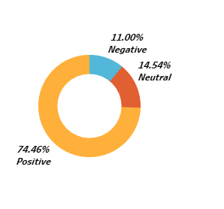
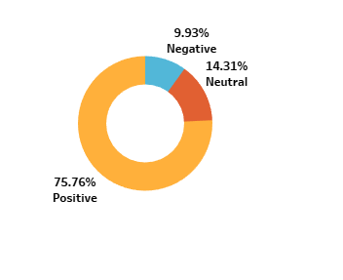
EXPLORATORY DATA ANALYSIS
Portion of sentiment
All Beauty Data
Magazine Subscription
Positive | 51333
Negative | 7584
Neutral | 10025
Positive | 36795
Negative | 4823
Neutral | 6949

Slide 7
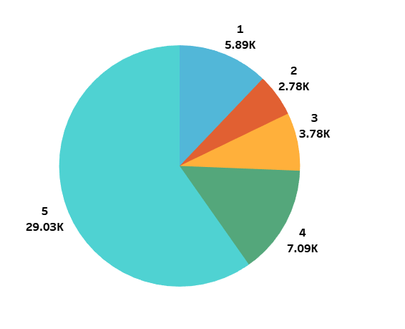
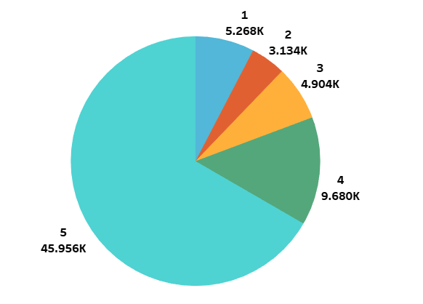
EXPLORATORY DATA ANALYSIS
Overall Ratings proportion
All Beauty Data
Magazine Subscription

Slide 8
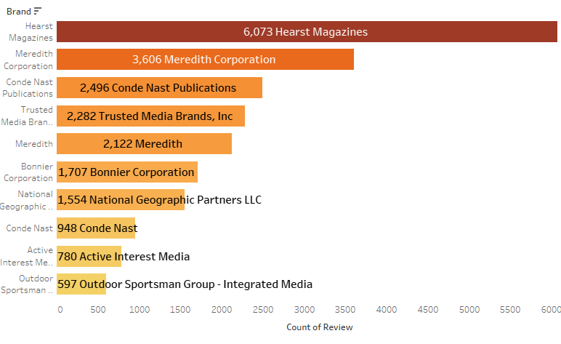
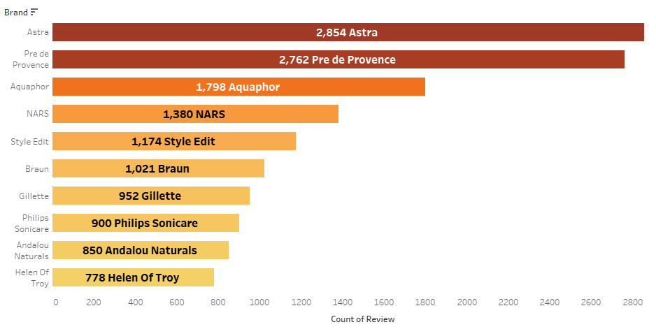
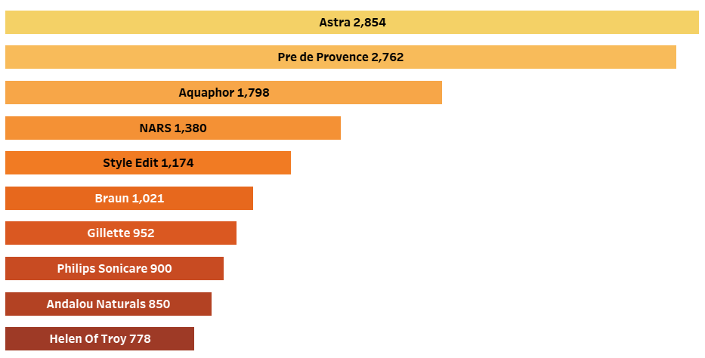
EXPLORATORY DATA ANALYSIS
Top 10 Positive Brands
All Beauty Data
Magazine Subscription

Slide 9
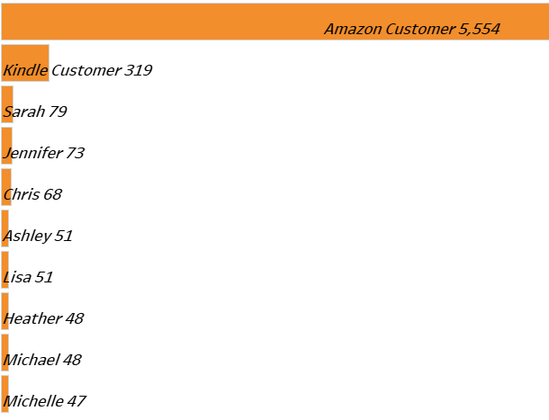
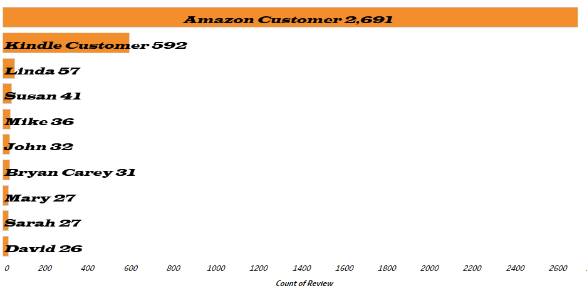
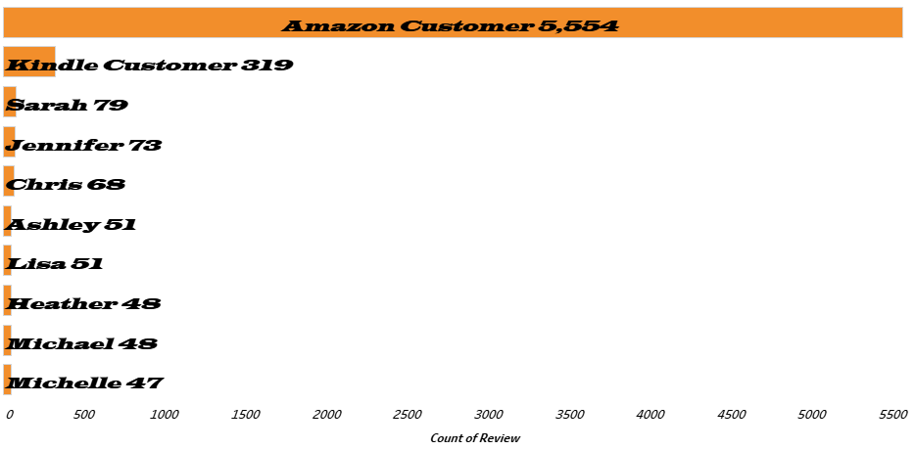
EXPLORATORY DATA ANALYSIS
All Beauty Data
Top 10 Customer
Magazine Subscription

Slide 10
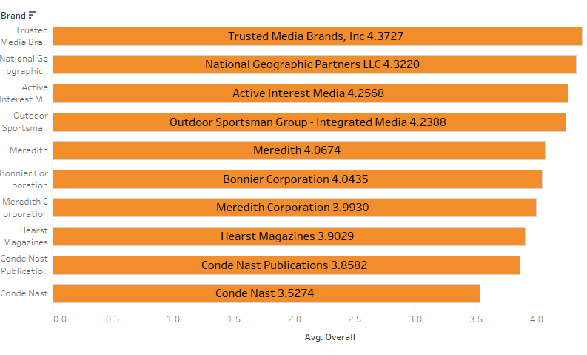
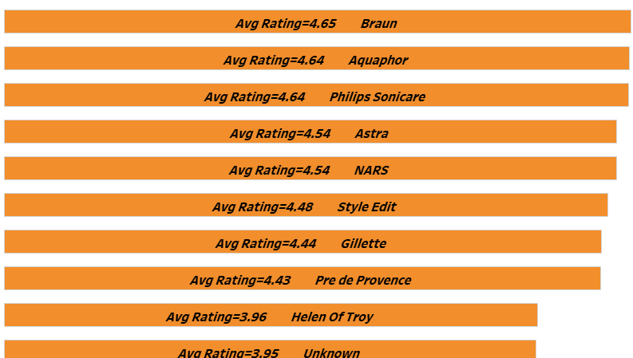
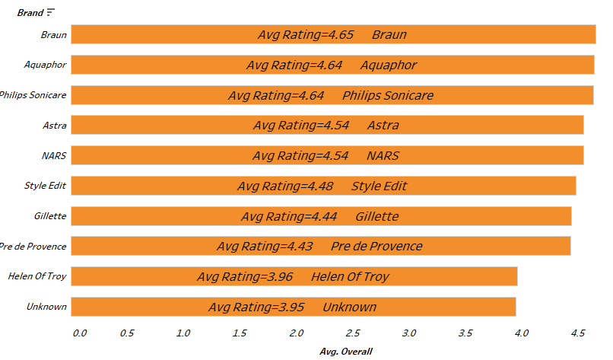
EXPLORATORY DATA ANALYSIS
Average rating of the top 10 identified brands
All Beauty Data
Magazine Subscription

Slide 11
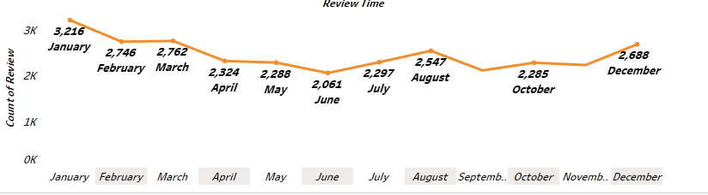
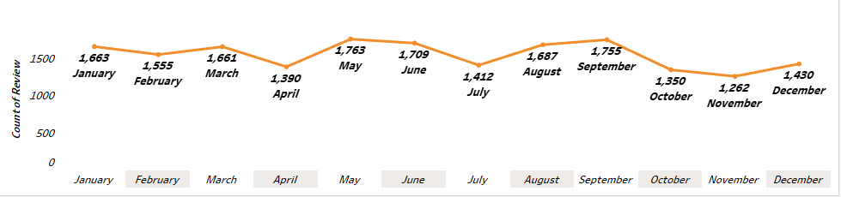
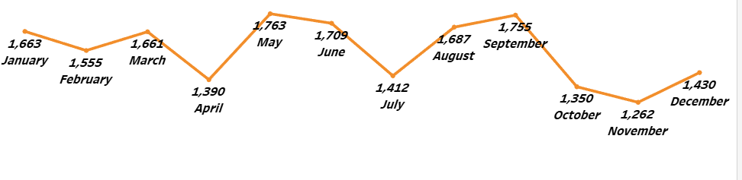
EXPLORATORY DATA ANALYSIS
Count of review of top 10 brands over the months
Magazine Subscription
All Beauty Data

Slide 12

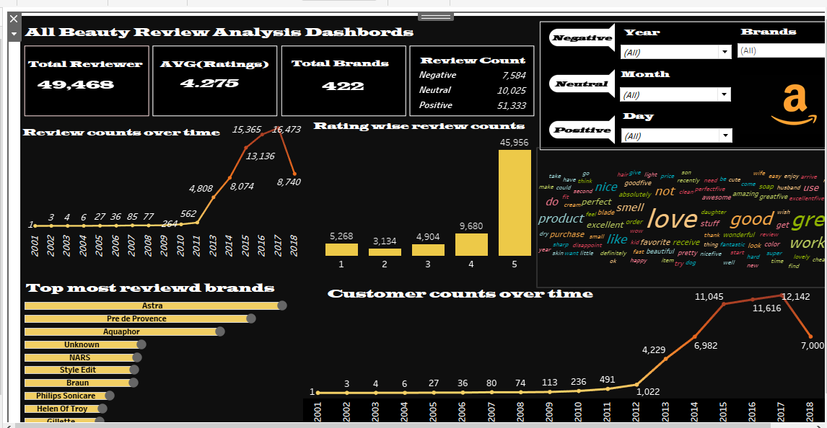
Dashboard
All Beauty
Click here
Magazine Subscription
Click here

Slide 13
TEXT CLASSIFICATION
Amazon reviews can be classified into positive, negative, or neutral sentiments based on the overall tone of the review. This can help businesses to understand how their customers feel about their products and identify areas for improvement.
Models
CVMNB-->CountVectorizer with Multinomial Naive Bayes
TFIDMNB-->TfidfVectorizer with Multinomial Naive Bayes
CVLR-->CountVectorizer with Logistic Regression
TFIDLR-->TfidfVectorizer with Logistic Regression
All Beauty Data
Magazine Subscriptions
 | Model | Accuracy | F1-Score
0 | CVMNB | 84.24 | 84.34
1 | TFIDMNB | 79.72 | 74.06
2 | CVLR | 93.35 | 93.15
3 | TFIDLR | 91.90 | 91.37
 | Model | Accuracy | F1-Score
0 | CVMNB | 85.10 | 84.85
1 | TFIDMNB | 80.87 | 75.59
2 | CVLR | 94.01 | 93.88
3 | TFIDLR | 93.15 | 92.74
CVLR and TFIDLR both have good accuracy and f1score, not much difference between the two. So we can use any model for Sentiment prediction

Slide 14

GUI for classification
All Beauty Data GUI based on Review

Slide 15
CUSTOMER SEGMENTATION
Customer segmentation is dividing customers into groups with similar characteristics to understand their needs and preferences. It helps businesses tailor their marketing efforts, improve customer satisfaction, and gain insights into customer behavior for better decision-making
RFM analysis
RFM analysis is a method used by businesses to analyze customer behavior based on three factors: Recency, Frequency, and Monetary value. This helps identify customers who are most valuable to the business and create targeted marketing strategies to improve customer retention and revenue.
All Beauty Data
 | recency | frequency | monetary
labels
Retention | 549.758142 | 1.000000 | 14.515733
Reactivation | 1549.301899 | 1.000000 | 16.190619
Up selling | 1082.607400 | 1.018499 | 150.210452
Loyalty | 964.267643 | 2.130255 | 37.308108
By targeting each of the four customer segments with tailored incentives and rewards, businesses can increase customer loyalty, retention, and revenue. Offering repeat purchase incentives, personalized emails, complementary products, and loyalty programs can all help improve the business's bottom line

Slide 16
Magazine Subscriptions
 | recency | frequency | rating
labels
Satisfied but Infrequent Shoppers | 3819.047396 | 1.044444 | 4.367332
Dissatisfied and Infrequent Shoppers | 1503.419892 | 1.025593 | 1.704605
Highly Satisfied but Infrequent Shoppers | 1210.454954 | 1.000000 | 4.818066
Frequent and Loyal Shoppers | 1415.000000 | 6.606796 | 4.330962
Moderately Satisfied and Frequent Shoppers | 1235.750644 | 2.306041 | 4.412062
By using rating columns, businesses can gain a better understanding of customer satisfaction, preferences, and behavior beyond just their purchase history or monetary value. This approach can help improve customer loyalty and retention by tailoring marketing strategies to meet customer expectations and needs
the key to improving customer retention is to understand the needs and preferences of each group of customers and to offer personalized experiences that meet their unique needs. By leveraging the insights gained from RFM analysis, you can develop targeted retention strategies that drive long-term customer loyalty and growth

Slide 17
TIME SERIES ANALYSIS
Time series analysis for sentiment aims to identify trends or patterns in customer opinions over time.
This involves collecting data on customer sentiment at regular intervals and using statistical methods to analyze it.
The insights gained from time series analysis can help businesses make informed decisions about marketing, product development, or customer service to improve customer satisfaction and increase revenue.

Slide 18
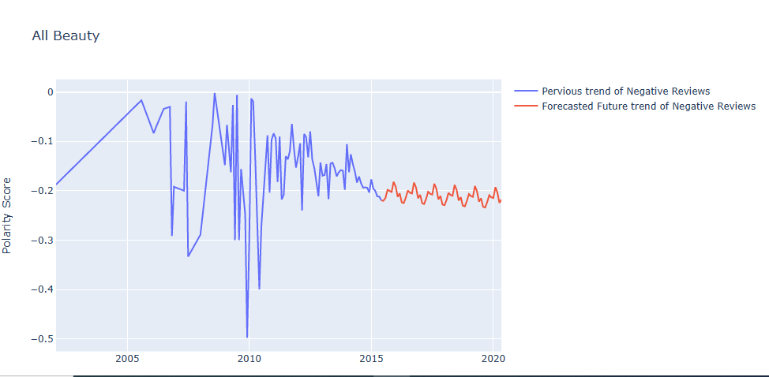
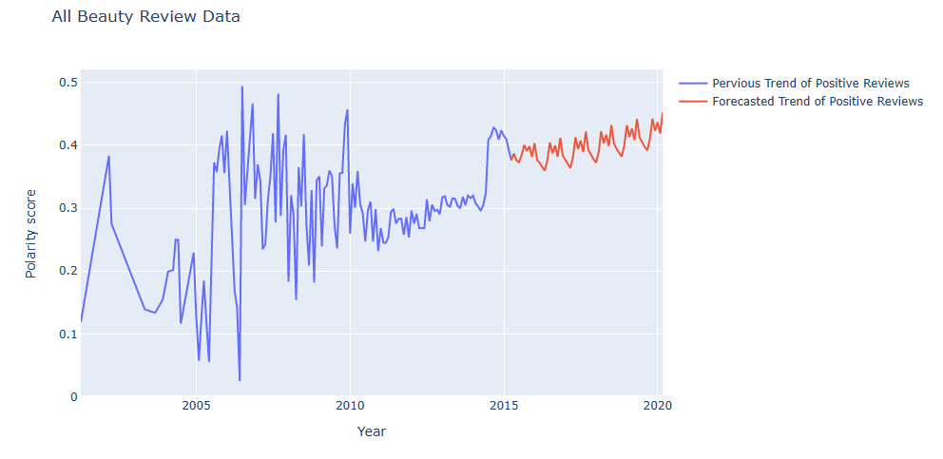
FORECASTING OF POSITIVE AND NEGATIVE SENTIMENTS
All Beauty Data
INTERPRETATION : Considering the All Beauty Dataset, the future trend for Positive sentiments is increasing and future trend for Negative sentiments is slightly decreasing.

Slide 19
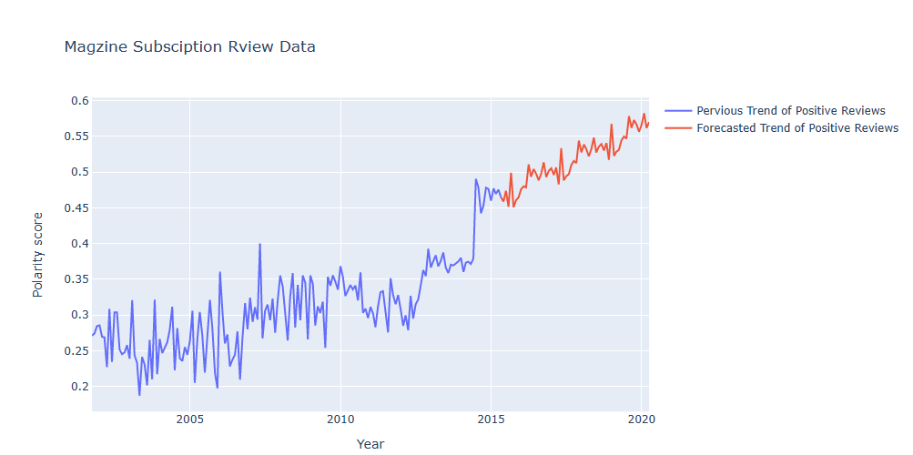
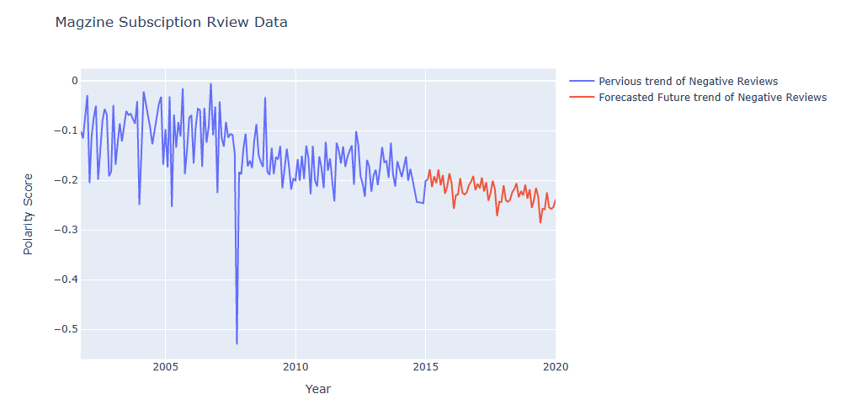
FORECASTING OF POSITIVE AND NEGATIVE SENTIMENTS
Magazine Subscriptions
INTERPRETATION : Considering the Magazine Subscription Dataset, the future trend for Positive sentiments is increasing and future trend for Negative sentiments is decreasing.

Slide 20
Conclusion
Conduct a thorough analysis of Amazon reviews for your products to understand customer satisfaction levels, identify areas for improvement, and gauge brand reputation.
Use customer feedback to inform future product design and development efforts.
Leverage review data to understand customer preferences and develop targeted marketing and advertising strategies.
Identify and understand different customer segments using RFM analysis to offer personalized experiences.
Implement retention strategies such as incentives, personalized offers, complementary products, and loyalty programs to improve customer retention and drive long-term loyalty.
Create an intuitive sentiment analysis GUI that enables users to analyze the sentiment of text inputs and receive a clear classification of positive, negative, or neutral sentiment

Slide 21
Thank you

